Slide 1




SUSTech Store
11910831 刘季冬
11911336 谭雅静
11811323 魏丰麟
11912636 侯伊林
11912933 徐卓琳
2021.11.25

Slide 2


CONTENT
01
Video Demo
02
What Has Been Done
03
What Needs to be done

Slide 3

1
Video Demo

Slide 4

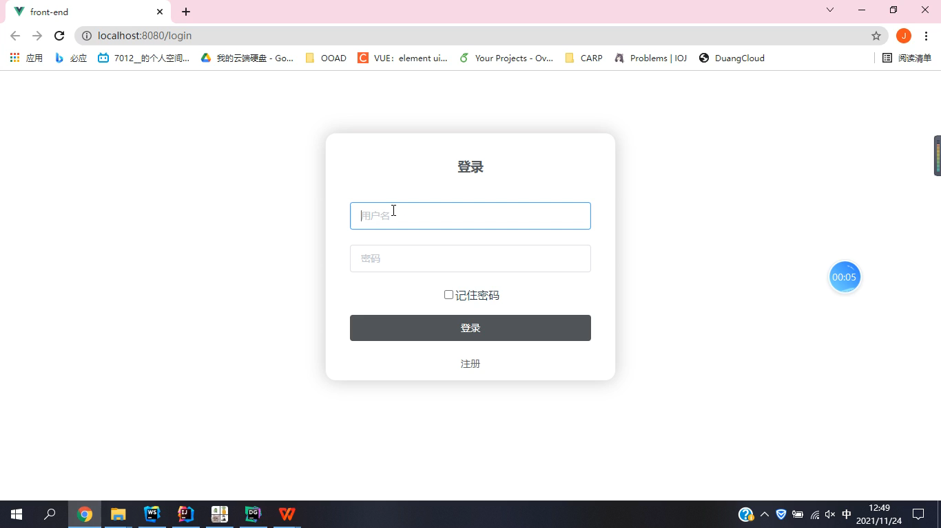
Personal Page

Slide 5
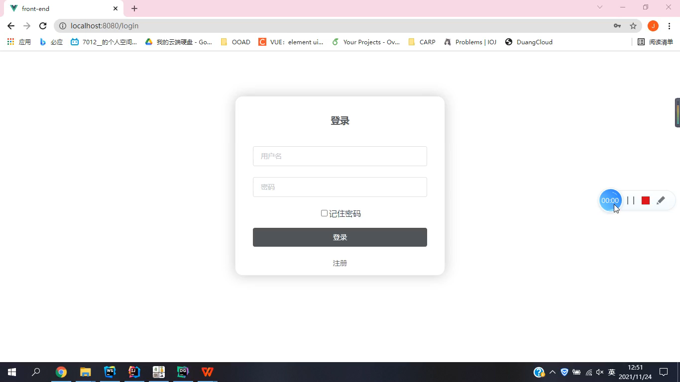
Sale Record

Slide 6
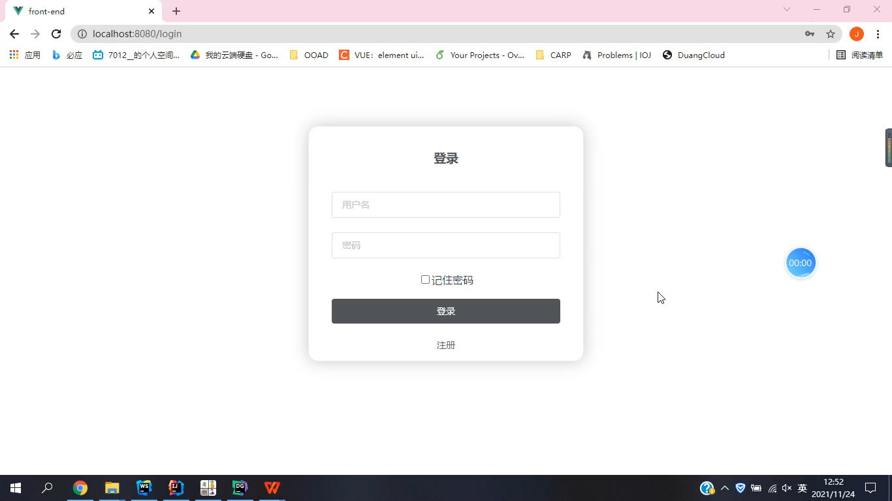
Purchasing

Slide 7
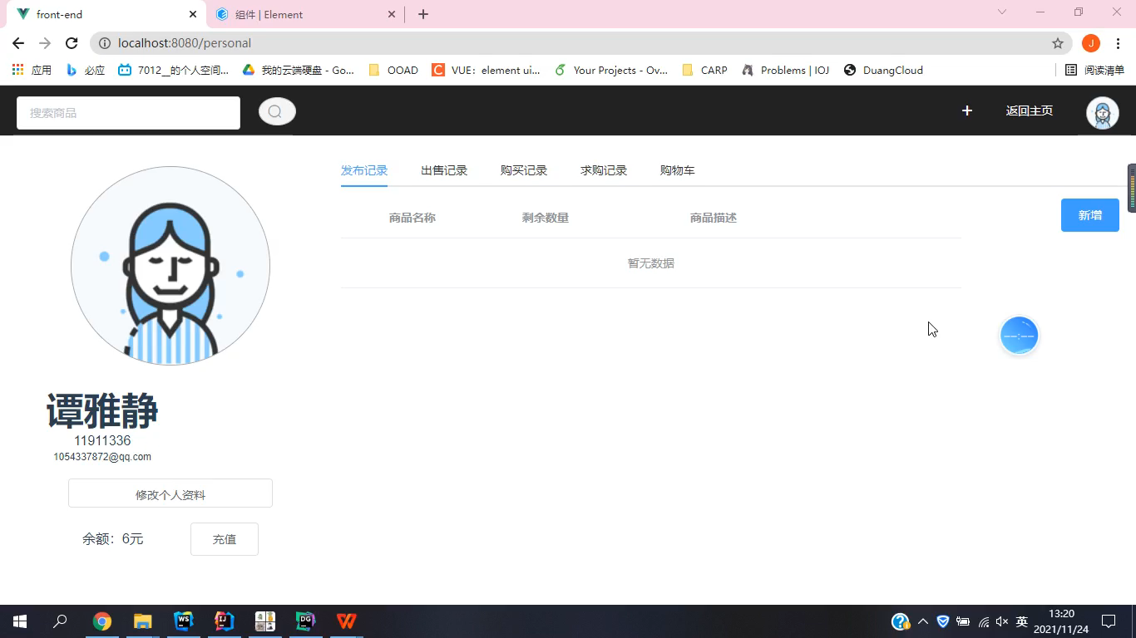
Posting Goods

Slide 8
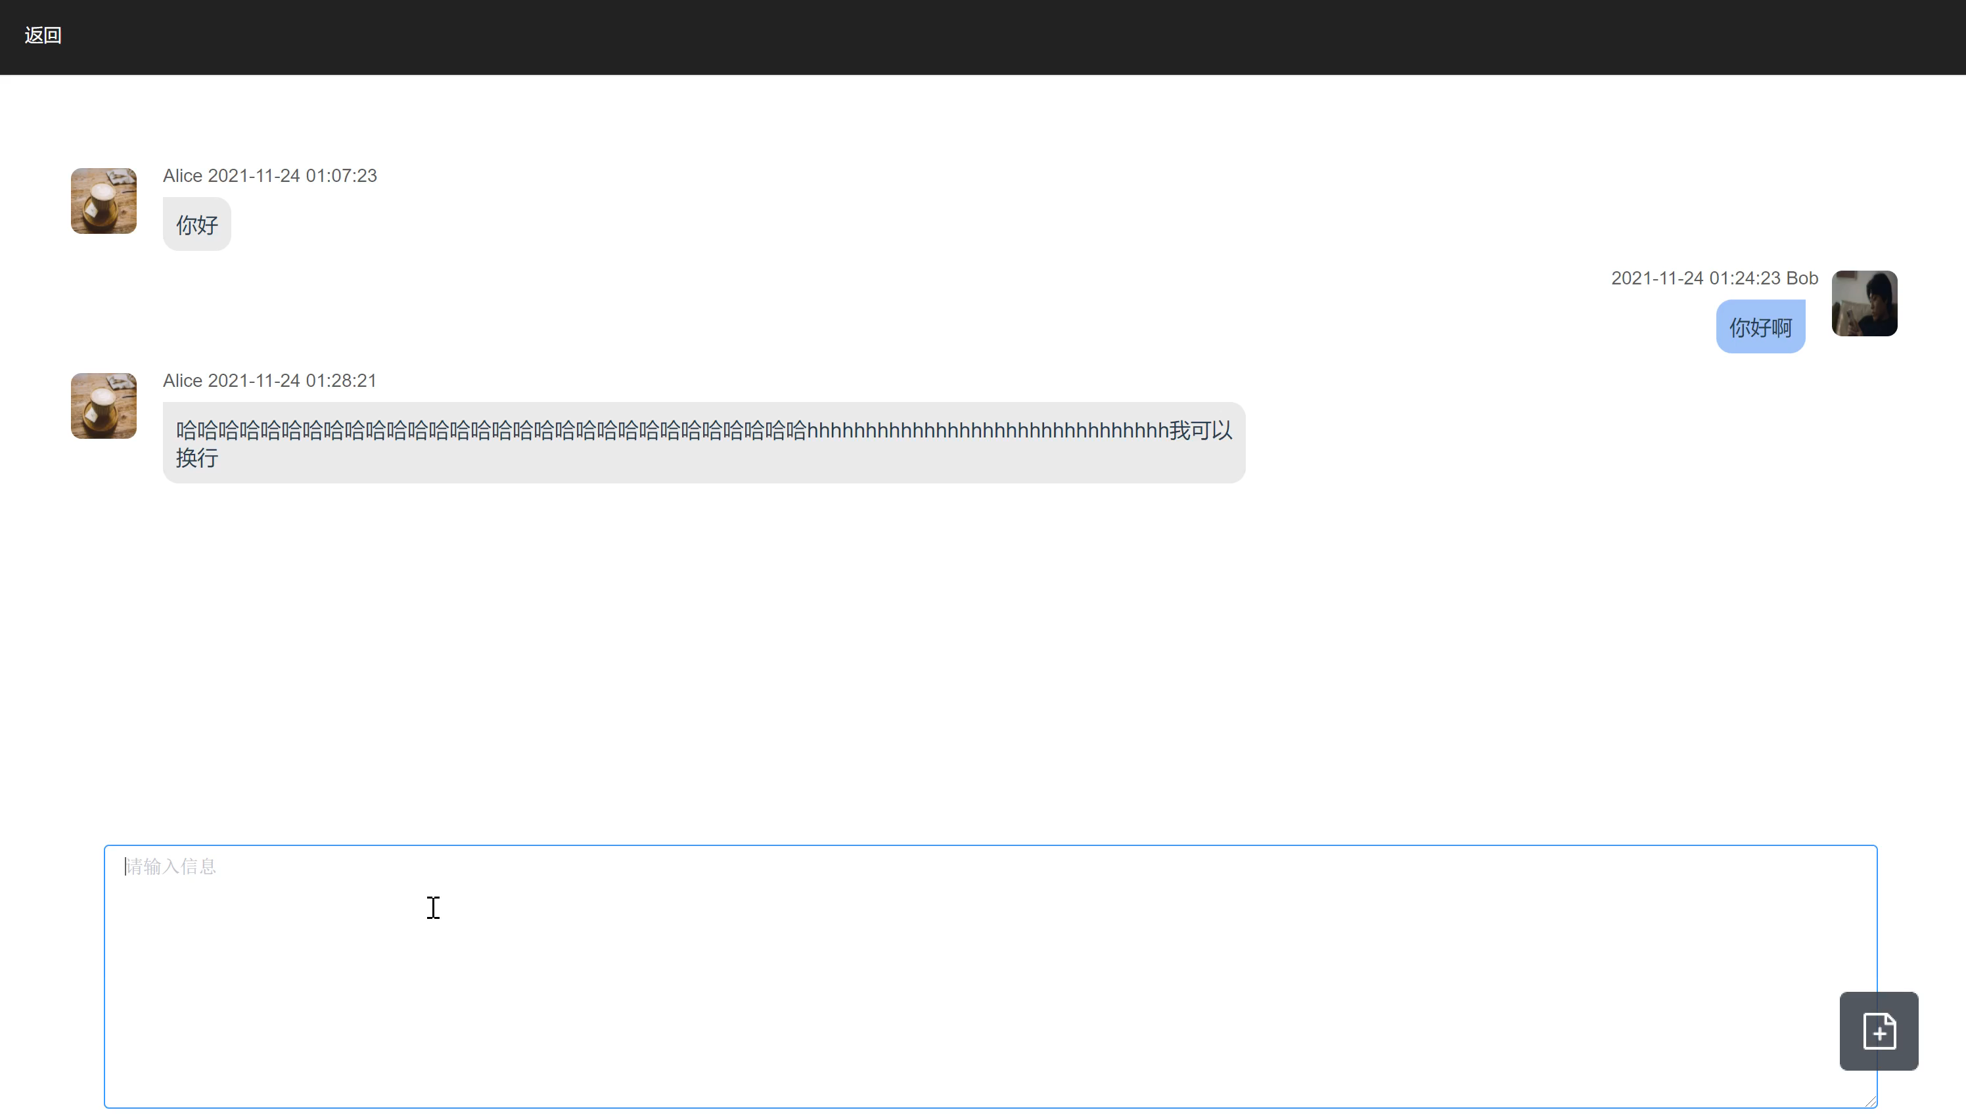
Chatting

Slide 9
2
What Has Been Done

Slide 10
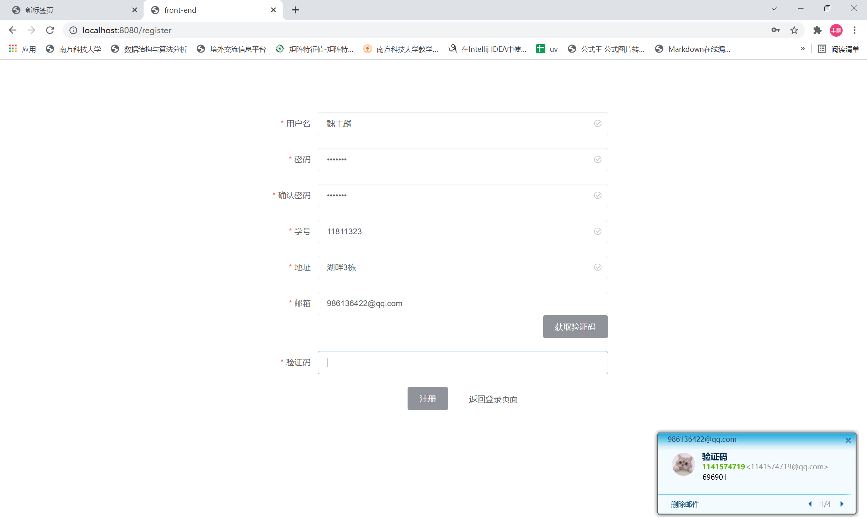

Register

Slide 11
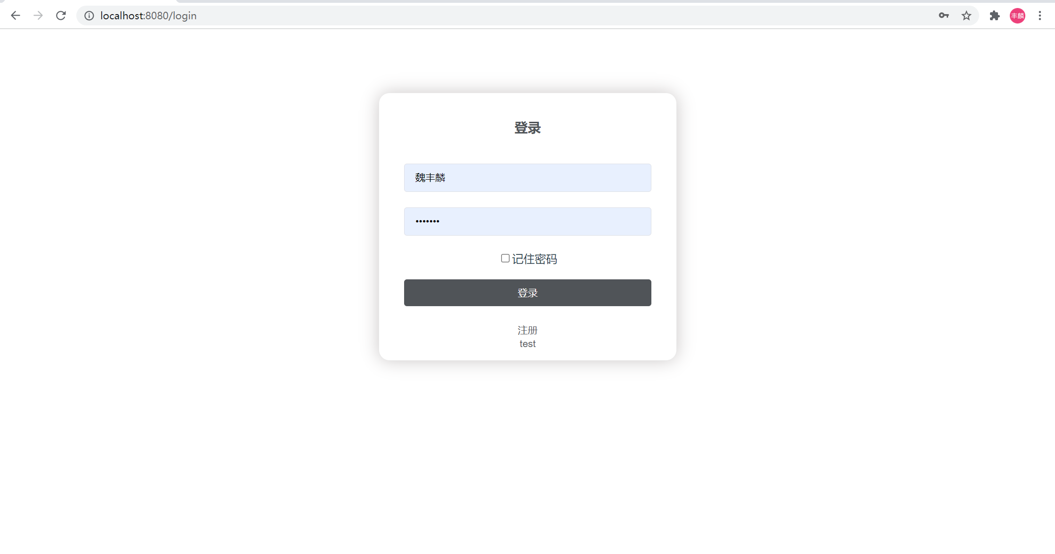
Login

Slide 12
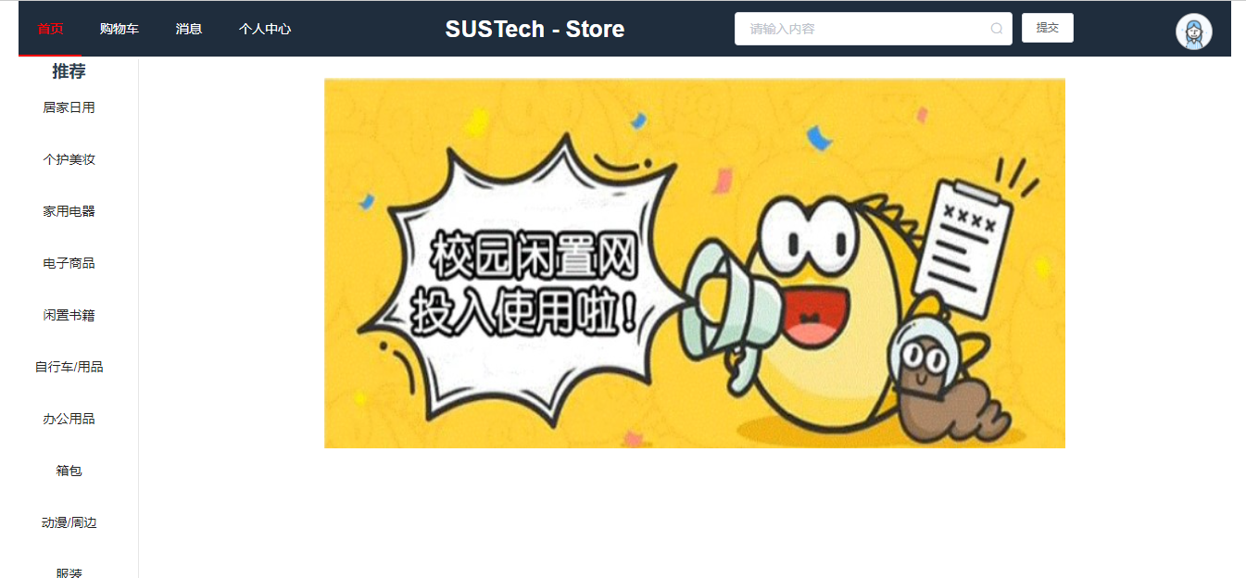
Homepage

Slide 13
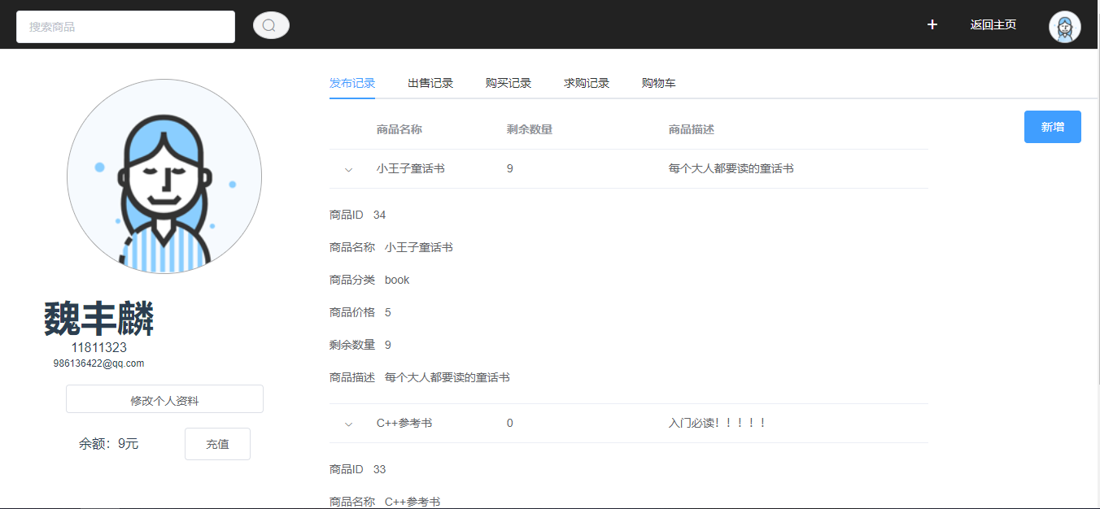
Posting Goods Record

Slide 14
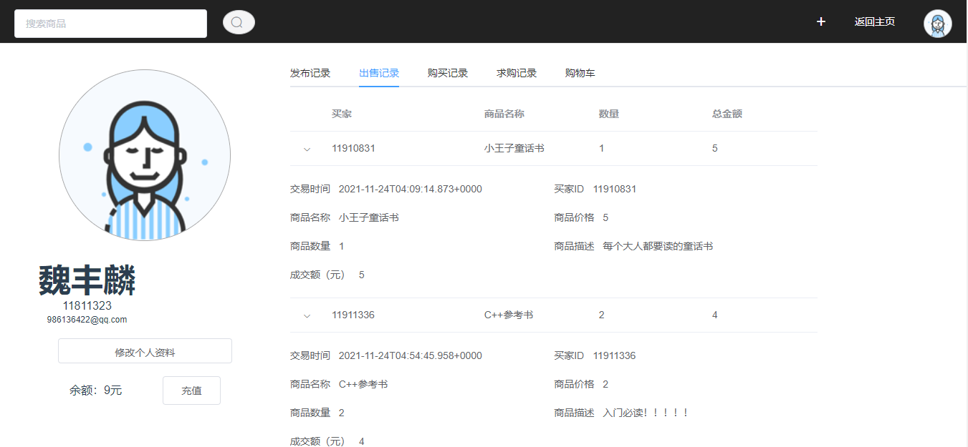
Sales Record

Slide 15
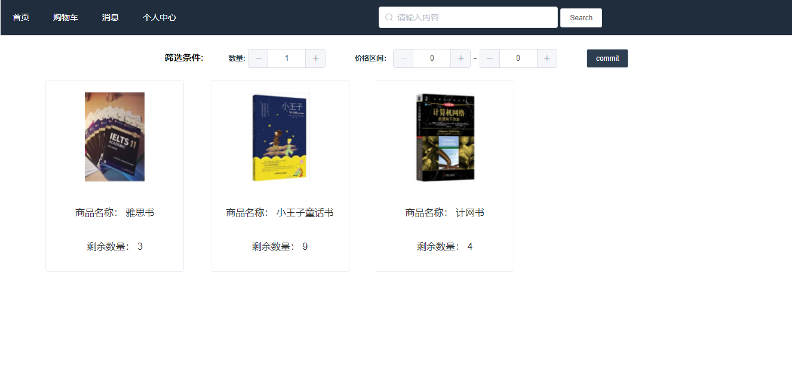
Listing Goods by Tag

Slide 16
3
What Needs to be done

Slide 17
What Needs to be done
Before 12.8
Online Chatting Function
Credit System
Before 12. 15
Adding elements related to SUSTech
Supporting purchasing agent service
Api Store

Slide 18
Thanks
2021.10.14

